Slide 1
Employee Data Analysis using Excel
STUDENT NAME : K. V. ASHWINI
REGISTER NO : 312208451
NM ID :19E811C526C207B95864FE7DBF297B74
DEPARTMENT : B.COM (COMMERCE)
COLLEGE : CHELLAMMAL WOMEN’S COLLEGE

Slide 2
PROJECT TITLE
Employee Recruitment Analysis using Excel

Slide 3


AGENDA
Problem Statement
Project Overview
End Users
Our Solution and Proposition
Dataset Description
Modelling Approach
Results and Discussion
Conclusion
3/21/2024 Annual Review

Slide 4

PROBLEM STATEMENT
This project is on Employee Data set Analysis using Basic information during the recruiting process
Employee Data set:-
Highlighted Employee Name , Department
Using filter, filtered Gender( Male in red, Female in Green)
Pie chart for First 10 Employee
Using Formulae, Employee who is paid maximum and minimum

Slide 5

PROJECT OVERVIEW
Using Excel function the Problem statements shall be addressed.

Slide 6

WHO ARE THE END USERS?
All these sorted data will be used by HR professionals, Management resources to view basic information of their employees

Slide 7

OUR SOLUTION AND ITS VALUE PROPOSITION
Filter, Advance filter by colour
Chart – Pie Chart
Sort – Custom sort
Sort by Date of joining

Slide 8
Dataset Description
Employee Data set
1.Draft Employee Dataset (Data derived during joining)
2.Features – 10
Emp ID
Name
Gender
Department
Salary
Start date
FTE
Employee Type
Work Location

Slide 9
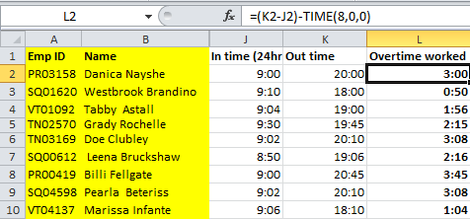

THE "WOW" IN OUR SOLUTION
Employee who worked overtime has been calculated using formula
3/21/2024 Annual Review
9

Slide 10
MODELLING
Data Collection
Data collected during date of joining from the employee
Data cleaning
Employee name and department were highlighted, Null Cell were Removed. Date Cell was formatted to Standard format (Month, Date, Year)
Techniques
Chart – Pie Chart
Formula
Minimum, Maximum
Over time Calculation
Function
Filter
Custom Sort
10

Slide 11
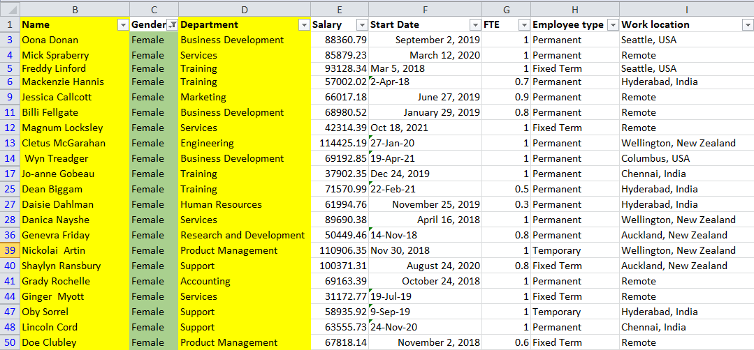
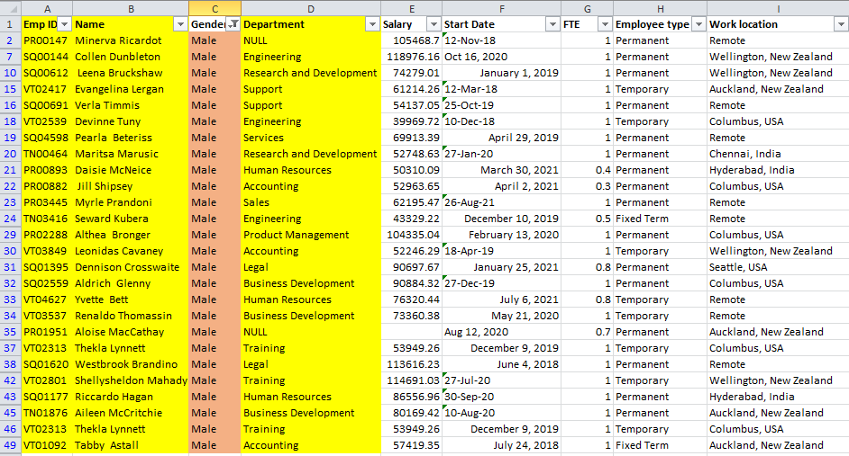
RESULTS
Using filter, Male and Female employee were filtered , Now using Advance filter by colour, Gender can be found by colors
11

Slide 12
Pie Chart for the first 10 employee has been graphed with their Salary using Chart
RESULTS

Slide 13
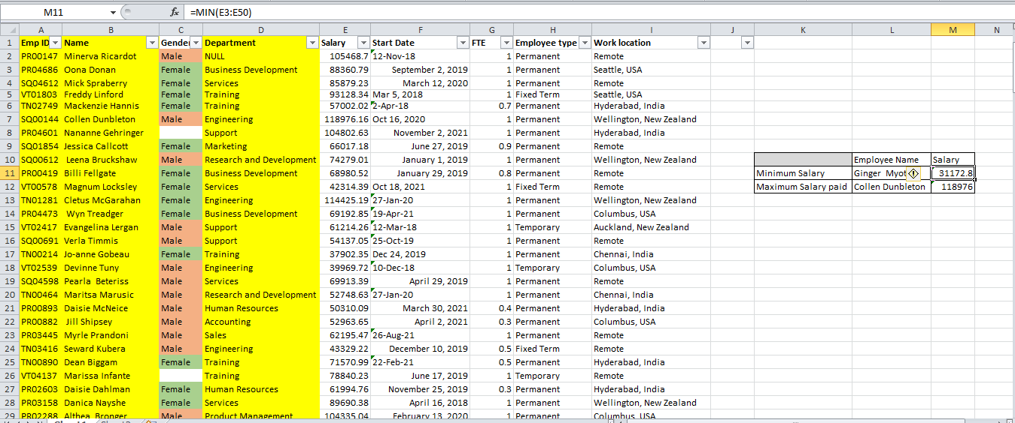
RESULTS
Using Formula, Minimum and Maximum Salary paid employee is found
Formula: =MIN(Value1, Value50), =MAX(Value1,Value50)
13

Slide 14
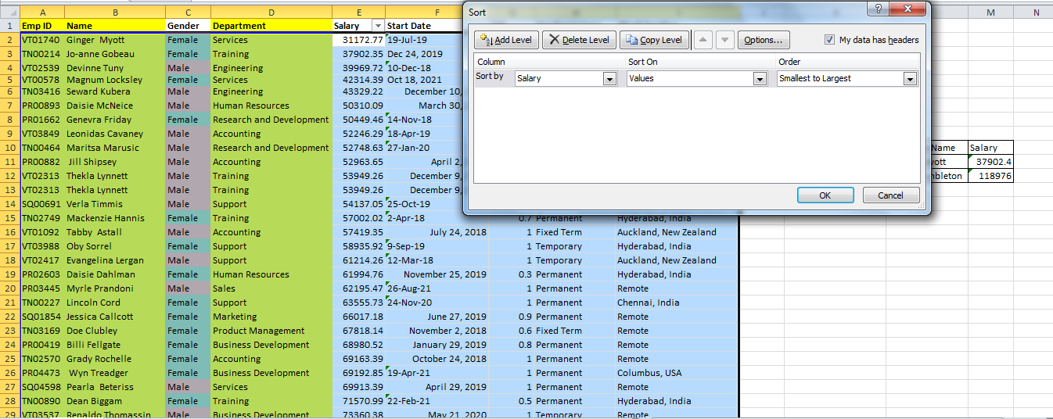
RESULTS
Using Sort Function, Employee getting paid from Minimum to Maximum is ordered

Slide 15
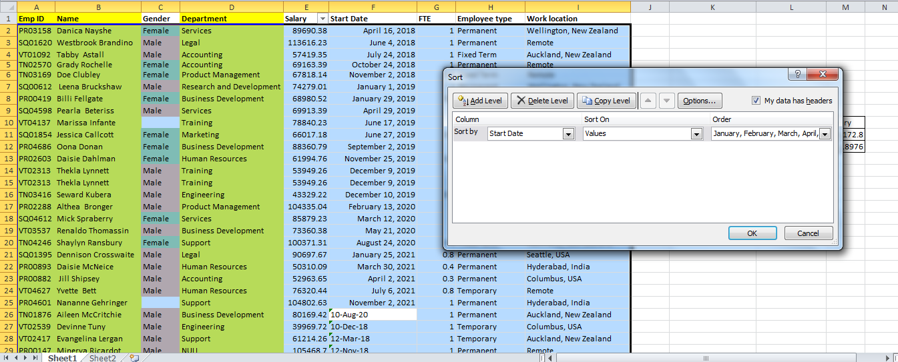
RESULTS
Using Sort Function, Employee’s date of joining is ordered

Slide 16
RESULTS
Employee who worked overtime has been calculated using formula
= (Out time – In time)-Time(Working hours, Minutes, Seconds)

Slide 17
CONCLUSION
Using the above information, it is concluded that information collected during Data joining has been cleaned, sorted and arranged.

